Slide 1
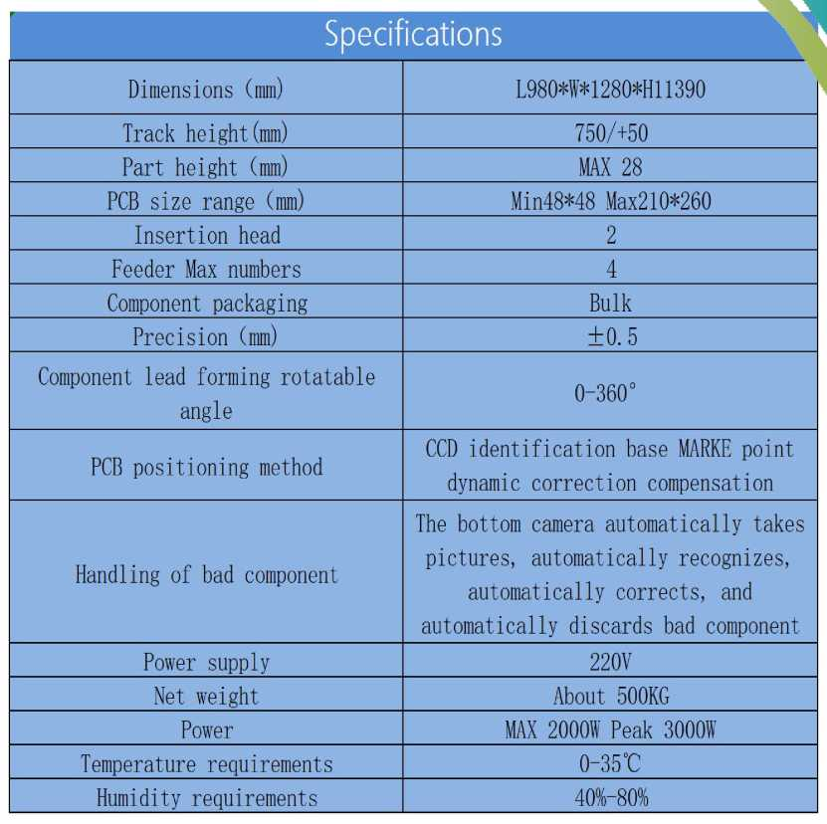
SOUTHERN MACHINERY
www.smthelp.com

Slide 2
SOUTHERN MACHINERY
Pluggable material reference
Capacitor part
Port socket
I * ■ « » w
junctor
Pressure coil
Large connector
integrated circuit
switching push-button
www.smthelp.com

Slide 3
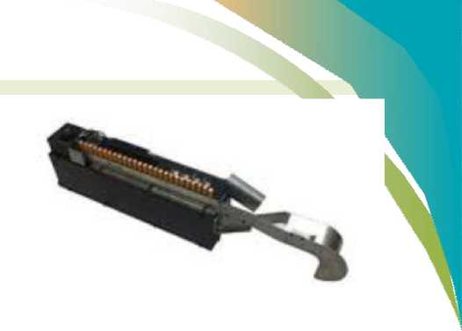
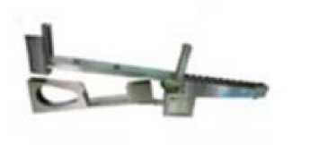
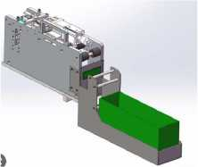
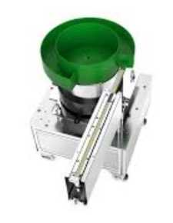
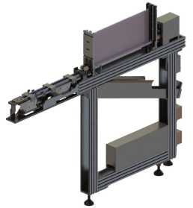
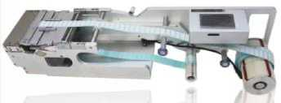
货 SOUTHERN J!/ MACHINERY
Variety feeding Method
Multi-tube feeder:Suitble for insertion machine and place&pick machine
Radial tape feeder: suitble insertion machine
Axail resistance feeder:suitble insertion machine and place&pick machine
and place&pick machine
Label feeder:Suitble for insertion machine and place&pick machine
Multi-tube external feeder:Suitble for insertion machine and place&pick machine
Bowl feeder:Suitble for
insertion machine and
place&pick machine
www.smthelp.com

Slide 4
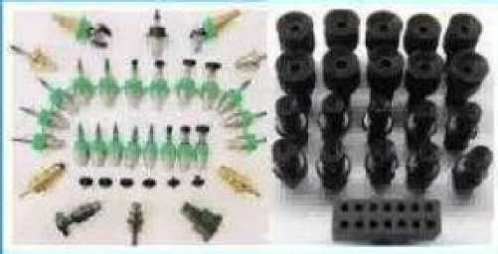
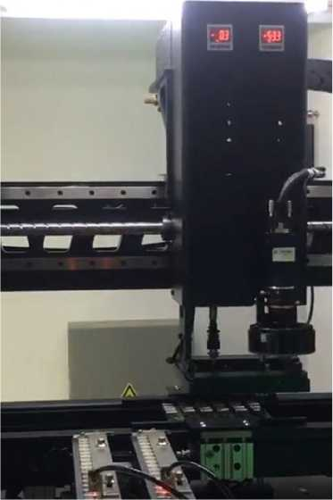
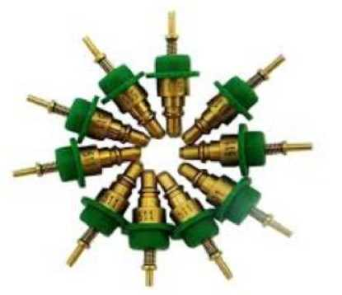
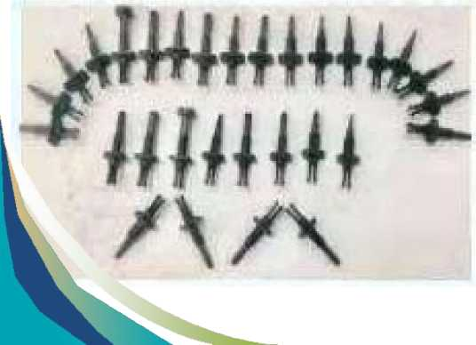
www.smthelp.com

Slide 5
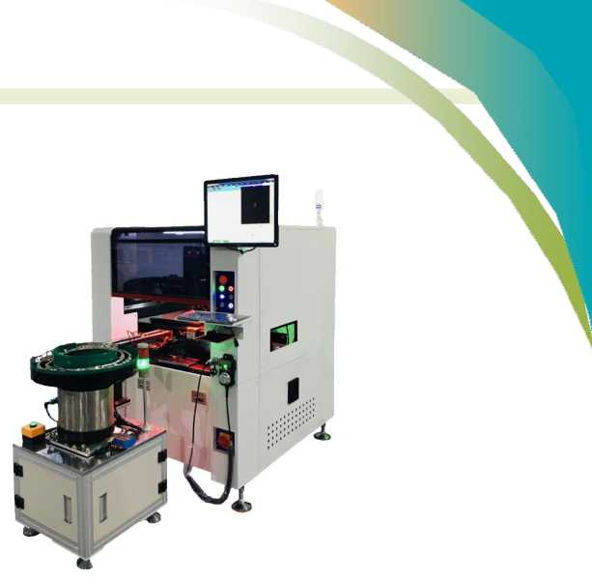
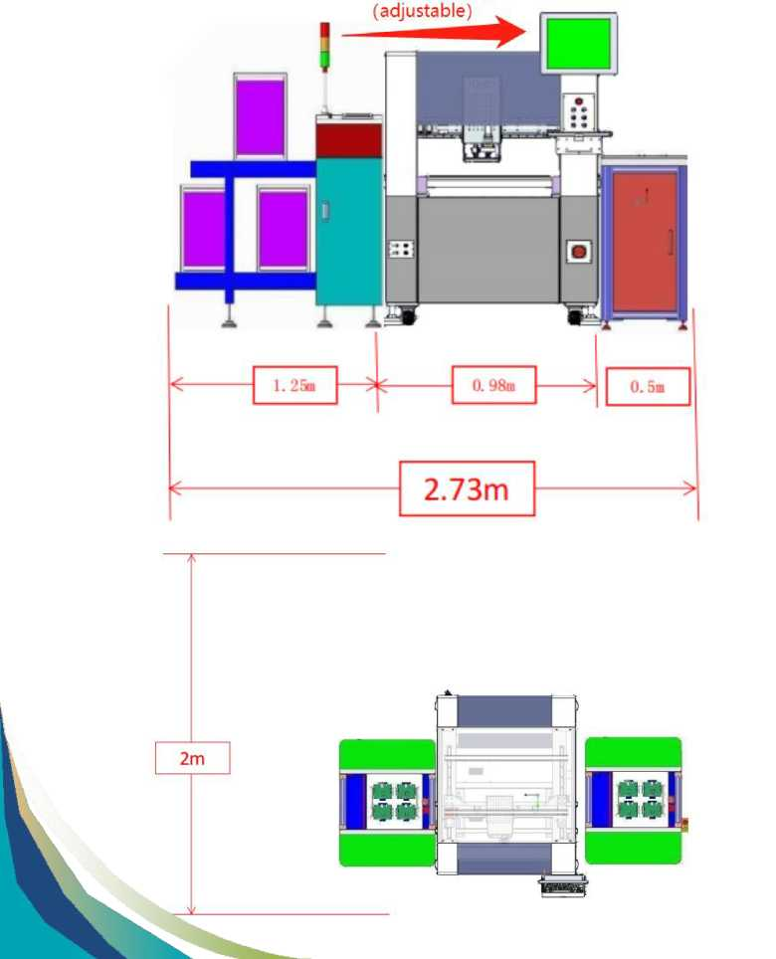
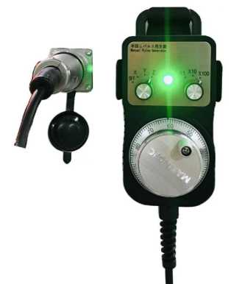
争澀KS Machine Layout
board left to right
www.smthelp.com

Slide 6
：)machine" Best After-sales Service
—7x24 Worldwide Support
—Free Installation/ Training
—1 day lead-time (spare parts)
—1 Month customize solution
www.smthelp.com

Slide 7
Welcome Inquiry
Please visit』
Find us more
www.smthelp.com
https://www.facebook.com/autoinsertion
> https://cn.linkedin.com/in/smtsupplier
Know more our team
Welcome to our factory in Shenzhen China
See more machine working video, please Youtube
Auto Insertion
Google
Auto+insertion, to get more information
info@smthelp.com
Looking forward to your email
www.smthelp.com

